Slide 1
Lecture 19
Fault-Model Based Structural Analog Testing
Analog fault models
Analog Fault Simulation
  DC fault simulation
  AC fault simulation
Analog Automatic Test-Pattern Generation
  Using Sensitivities
  Using Signal Flow Graphs
Summary

Slide 2
Types of Structural Faults
Catastrophic (hard):
  Component is completely open or completely shorted
  Easy to test for
Parametric (soft):
  Analog R, C, L, K_{n}, or K_{p} (a transistor K parameter) is outside of its tolerance box)
  Very hard to test for

Slide 3
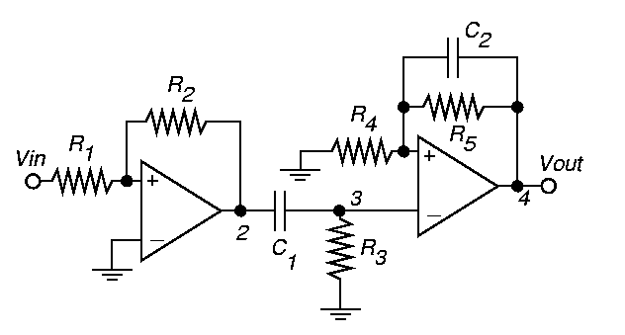
Analog Fault Models
First stage gain R₂ / R₁
High-pass filter gain R₃ and C₁
High-pass filter cutoff f C₁
Low-pass AC voltage gain R₄, R₅, & C₂
Low-pass DC voltage gain R₄ and R₅
Low-pass filter cutoff f C₂

Slide 4
Levels of Abstraction
Structural Level
  Structural View – Transistor schematic
  Behavioral View – System of non-linear partial differential equations for netlist
Functional Level
  Structural View – Signal Flow Graph
  Behavioral View – Analog network transfer function

Slide 5
Analog Test Types
Specification Tests
  Design characterization – Does design meet specifications?
  Diagnostic – Find cause of failures
  Production tests – Test large numbers of linear/mixed-signal circuits

Slide 6
DC Analog Fault Simulation

Slide 7
Complementarity Pivoting
P. M.Lin and Y. S. Elcherif, Analogue Circuits Fault Dictionary – New Approaches and Implementation, Int’l. J. of Circuit Theory and Applications, 1985
Model all non-linear devices with piecewise-linear I-V characteristics (ideal diodes)
Represent open, short, and parametric faults with switches
Formulate as n-port network complementarity problem
Solve with Lemke’s complementarity pivoting algorithm
  Use m pairs of complementarity variables (port currents and voltages)

Slide 8
One-Step Relaxation
W. Tian and C.-J. Shi, Nonlinear DC-Fault Simulation by One-Step Relaxation – Linear Circuit Models are Sufficient for Nonlinear DC–Fault Simulation, VTS-1998
Solve f (x) = 0, x is circuit variable vector (node voltages and branch currents), f is non-linear system function
Guess x (0)
Solve Jacobian: J_{f} (x_{g}) (x_{f}⁽¹⁾ – x_{g})= -f_{f} (x_{g})
Operate Newton-Raphson algorithm for only 1 step

Slide 9
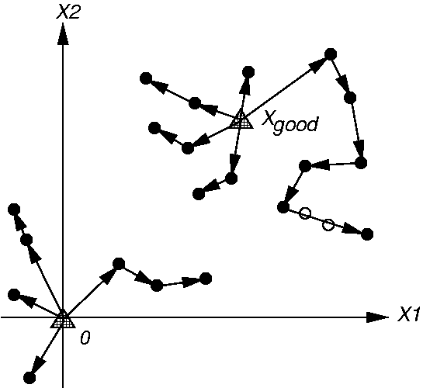
Fault Ordering
  W. Tian and C.-J. Shi, Efficient DC Fault Simulation of Nonlinear Analog Circuits, DATE-98

Slide 10
AC Fault Simulation

Slide 11
Householder’s Formula
A. S. Householder, A Survey of Some Closed Methods for Inverting Matrices, SIAM J. of Applied Mathematics, 1957
Analyze circuit with Modified Nodal Analysis:
T x = w
Equivalent faulty circuit equation:
T_{f} x_{f} = w_{f}
Formula (T_{f} differs only a little from T):
(A + U S W)⁻¹ = A⁻¹ – A⁻¹ U (S⁻¹ + WA⁻¹ U)⁻¹ W A⁻¹
Reduces amount of equation solving – 10 x speedup over sparse matrix techniques

Slide 12
Discrete Z-Domain Mapping
Nagi, Chatterjee, Abraham, DRAFTS: Discretized Analog Circuit Fault Simulator, Design Automation Conference, 1993
Analog circuit fault simulation with Signal Flow Graph (SFG)
Represented complex frequency state equations using SFGs and dummy variables
Use bilinear transform, map s-domain equations into z-domain
Accelerated fault simulation 10 times with behavioral OPAMP models

Slide 13
Monte-Carlo Simulation
Perform analog simulation for randomly-generated small variations in analog circuit component values
Actual IC manufacturing makes good circuits deviate by such values
Good in practice but good and bad machines have different worst-case corners
  Tends to underestimate circuit response bounds – may claim faults are detectable when they are not

Slide 14
Analog Automatic Test-Pattern Generation

Slide 15
Method of ATPG Using Sensitivities
N. B. Hamida and B. Kaminska, Analog Circuit Testing Based on Sensitivity Computation and New Circuit Modeling, ITC-1993
Compute analog circuit sensitivities
Construct analog circuit bipartite graph
From graph, find which O/P parameters (performances) to measure to guarantee maximal coverage of parametric faults
  Determine which O/P parameters are most sensitive to faults
Evaluate test quality, add test points to complete the analog fault coverage

Slide 16
Sensitivity
Differential:
S =
Incremental:
ρ = x
T_{j} – performance parameter
x_{i} – network element
T_{j}
x_{i} T_{j}
T_{j} x_{i}
Δ T_{j} / T_{j}
Δ x_{i} / x_{i}
x_{i}
Δ x_{i} 0
T_{j}
x_{i}
T_{j}
Δ T_{j}
Δ x_{i}
x_{i}

Slide 17
Circuit Model

Slide 18
Incremental Sensitivity Matrix of Circuit
-0.91
0
0
0
0
0
R₁
1
0
0
0
0
0
R₂
0
0.58
-0.91
0
0
0
C₁
0
0.38
-0.89
0
0
0
R₃
0
0
0
-0.96
-0.97
0
R₄
0
0
0
0.48
-0.97
-0.88
R₅
0
0
0
-0.48
0
-0.91
C₂
A₁
A₂
fc₁
A₃
A₄
fc₂
\

Slide 19
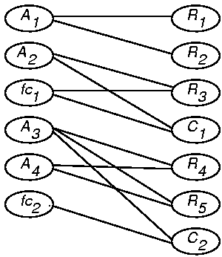
Bipartite Graph of Circuit

Slide 20
Single Fault Best and Worst-Case Deviations
5 14.81
5 15.2
5 14.65
5 13.96
5 15
5 35
5 35
ΔR₁
R₁
ΔR₂
R₂
ΔR₃
R₃
ΔC₁
C₁
ΔR₄
R₄
ΔR₅
R₅
ΔR₃
R₃
ΔC₁
C₁
ΔR₅
R₅
ΔC₂
C₂
ΔR₄
R₄
ΔR₅
R₅
ΔC₂
C₂
5 15.98
5 14.1
5 20.27
5 11.6
5 15
5 15
fc1
fc2
A3
A1
A2
A4

Slide 21
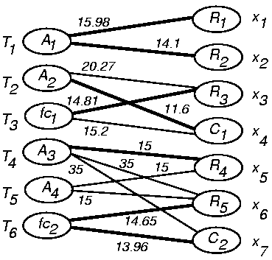
Weighted Bipartite Graph

Slide 22
Analog ATPG Using Signal Flow Graphs
R. Ramadoss and M. L. Bushnell, Test Generation for Mixed-Signal Devices Using Signal Flow Graphs, VLSI Design-1996
Generates tests and defines parametric faults for analog circuits
ATPG Approach:
  Backtraces signals from circuit outputs (specified with magnitude/phase tolerance) through circuit using signal flow graph (SFG)
    Inverts the SFG to allow backtracing
  Evaluates internal waveforms using an output waveform sample set by evaluating SFG

Slide 23
Test Generation via Reverse Simulation
Find good circuit signal values at all nodes using good output waveform
Find bad circuit signal values at all nodes using bad output waveform (use extrema of tolerance box for magnitude or phase)
Finds faulty value of analog component necessary to drive output waveform out of tolerance box
  Mark all corresponding edges to fault
  Compute modified SFG weights that give good value after bad edges in inverted SFG

Slide 24
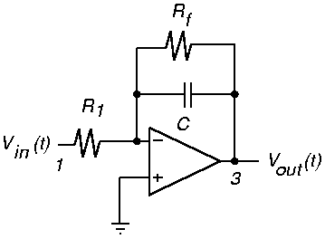
Integrator Example
Basic integrator circuit with ideal OPAMP

Slide 25
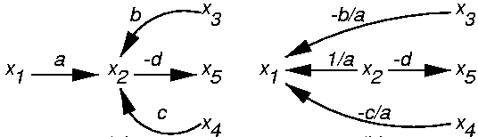
Signal Flow Graph Inversion
SFG represents analog network equations
value (i) = Σ (parent node value) (edge weight)
May be inverted
x₂ = ax₁ + bx₃ + cx₄ x₁ = 1/a x₂ – b/a x₃ - c/a x₄
ORIGINAL GRAPH INVERTED GRAPH
SFG inversion algorithm follows from Balabanian’s example (1969)

Slide 26
SFG Inversion Algorithm
Start at a primary input, x₁, a source node
Reverse the direction of the outgoing edge from x₁ to x₂ and change the weight to 1/a
Redirect all edges incident on x₂ to x₁ and change weights appropriately
Continue for all source nodes, from all inputs, until the output becomes a source
Inverted SFG Properties:
Equivalent to original SFG
A feed-forward network – graph cycles cut
Represents set of integral equations, solved by numerical differentiation
May be an unstable system

Slide 27
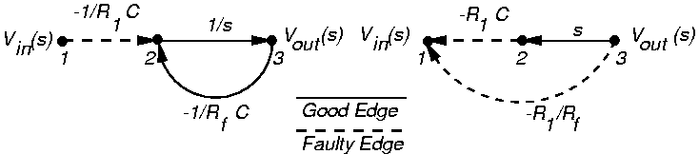
Graphs for Integrator
SFG part after fault has faulty value
Bad signal does not disappear, circuits are linear
Method applicable to all circuits representable with SFGs (1st and 2nd order)
Backtrace over all paths from outputs to inputs
2nd order approximation for s differential operator
Original SFG
Inverted SFG

Slide 28
Analog Fault Definition
Want to find parametric fault value for R₁
Use good & bad node values for all nodes from reverse analog simulation
For parametric fault definition in inverted SFG
  Use good values for nodes before fault
  Use bad values for nodes after fault
  Linear equation in 1 variable for each component
  Manipulate component equations symbolically to get component tolerance

Slide 29
Calculation of R1 Tolerance to Cause Fault
Original SFG
Inverted SFG
goodval (1) badval (3)
-R₁ C -R_{f} C
badval (R₁) - goodval (1)
C (badval (2) + badval (3) / R_{f} C)
goodval (R₁) - goodval (1)
C (goodval (2) + goodval (3) / R_{f} C)
R₁ _{Tolerance} = goodval (R₁) – badval (R₁)
+ = badval (2)
=
=

Slide 30
SFG ATPG Results
R₁ = 10 KΩ, R_{f} = 100 KΩ, C = 0.01 μF
Output tolerance = +10%, used SPICE output
Calculated test signal and component deviations
Deviations analogous to fault coverage
Component
R₁
R_{f}
C
Allowed Value
9.09 KΩ
80.99 KΩ
0.0093 μF
Deviation
-9.1%
-19.01%
-7.0%

Slide 31
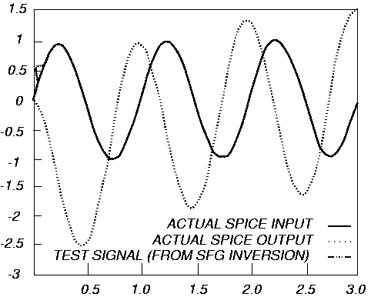
Generated Test Waveform
Voltage
Time (ms)

Slide 32
Summary of SFG Method
Works for multiple input, multiple output circuits
Handles single and multiple parametric faults, and catastrophic faults
  Symbolic solution too difficult for multiple parametric fault tolerance – use iterative method with simulation to obtain deviation
Extended to cover transistor biasing faults in analog circuits
Extended to analog multipliers and comparators

Slide 33
Summary
Analog model-based testing – Just starting to get some acceptance
  Structural test with a fault model
  Offers advantage of testing specific parametric and catastrophic faults
Analog DSP-based testing – Main stream
  Functional test without fault model
Problem is worsening – 22-bit A/D converters coming, expected to sample at 1 GHz

